Slide 1
Topic analysis
John Chen, Jing Yu

Slide 2
What topics are most prevalent in the tweets?

Slide 3
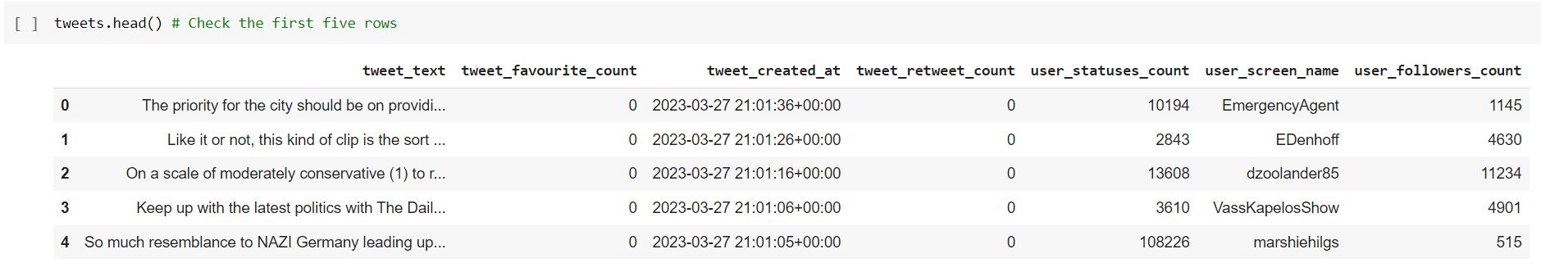
The data we used
Dimension: 10,000 observations with 7 attributes
Retweets excluded and searched for tweets with #cdnpoli
We are extracting topics from opinions

Slide 4
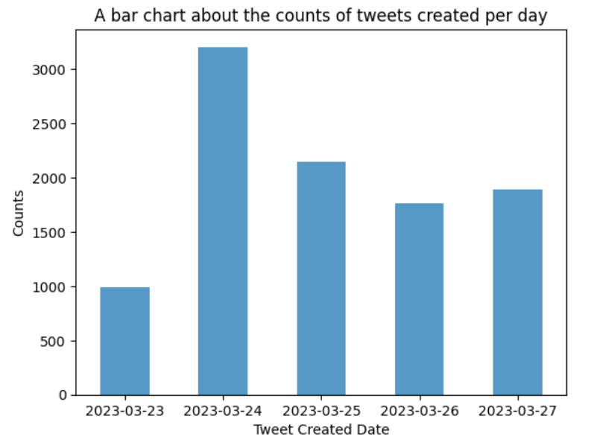
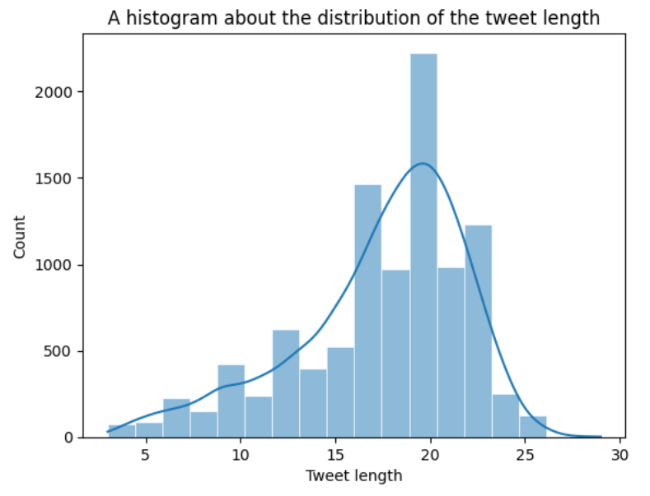
Date and Tweet length
Suggest that the topics being talked about are relevant during March 23 to 27

Slide 5
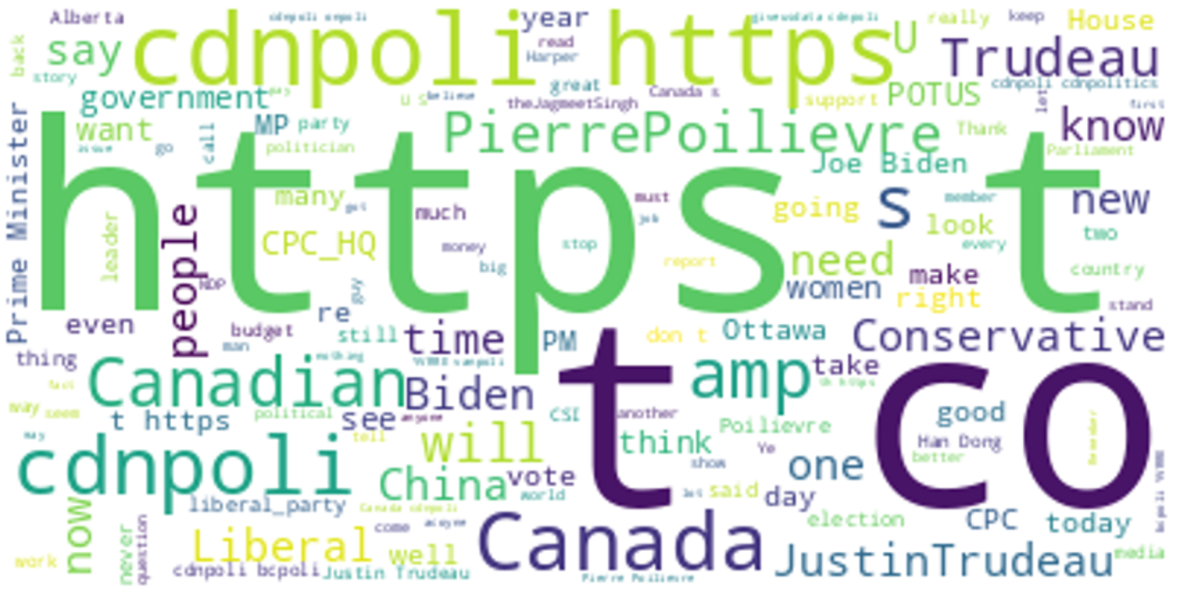
Most common words

Slide 6
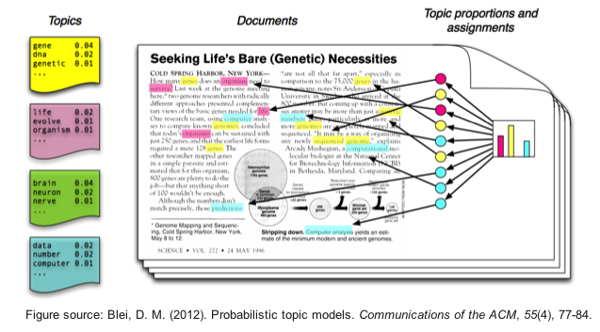
Machine Learning Task
Topic modelling: Latent Dirichlet Allocation (LDA)

Slide 7
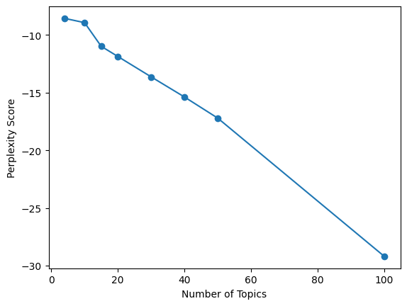
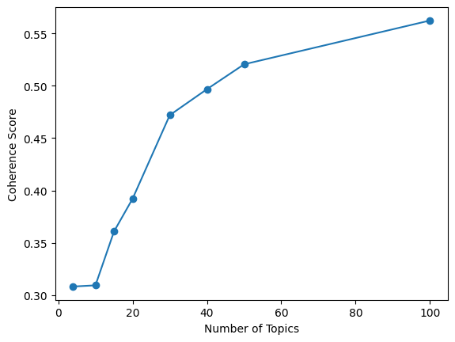
Latent Dirichlet Allocation (LDA)
Unsupervised model
Strength: No need to label the data beforehand
Weakness: Number of topics must be specified beforehand
Evaluate performance:
Low Perplexity: -17
High Coherence: 0.525

Slide 8
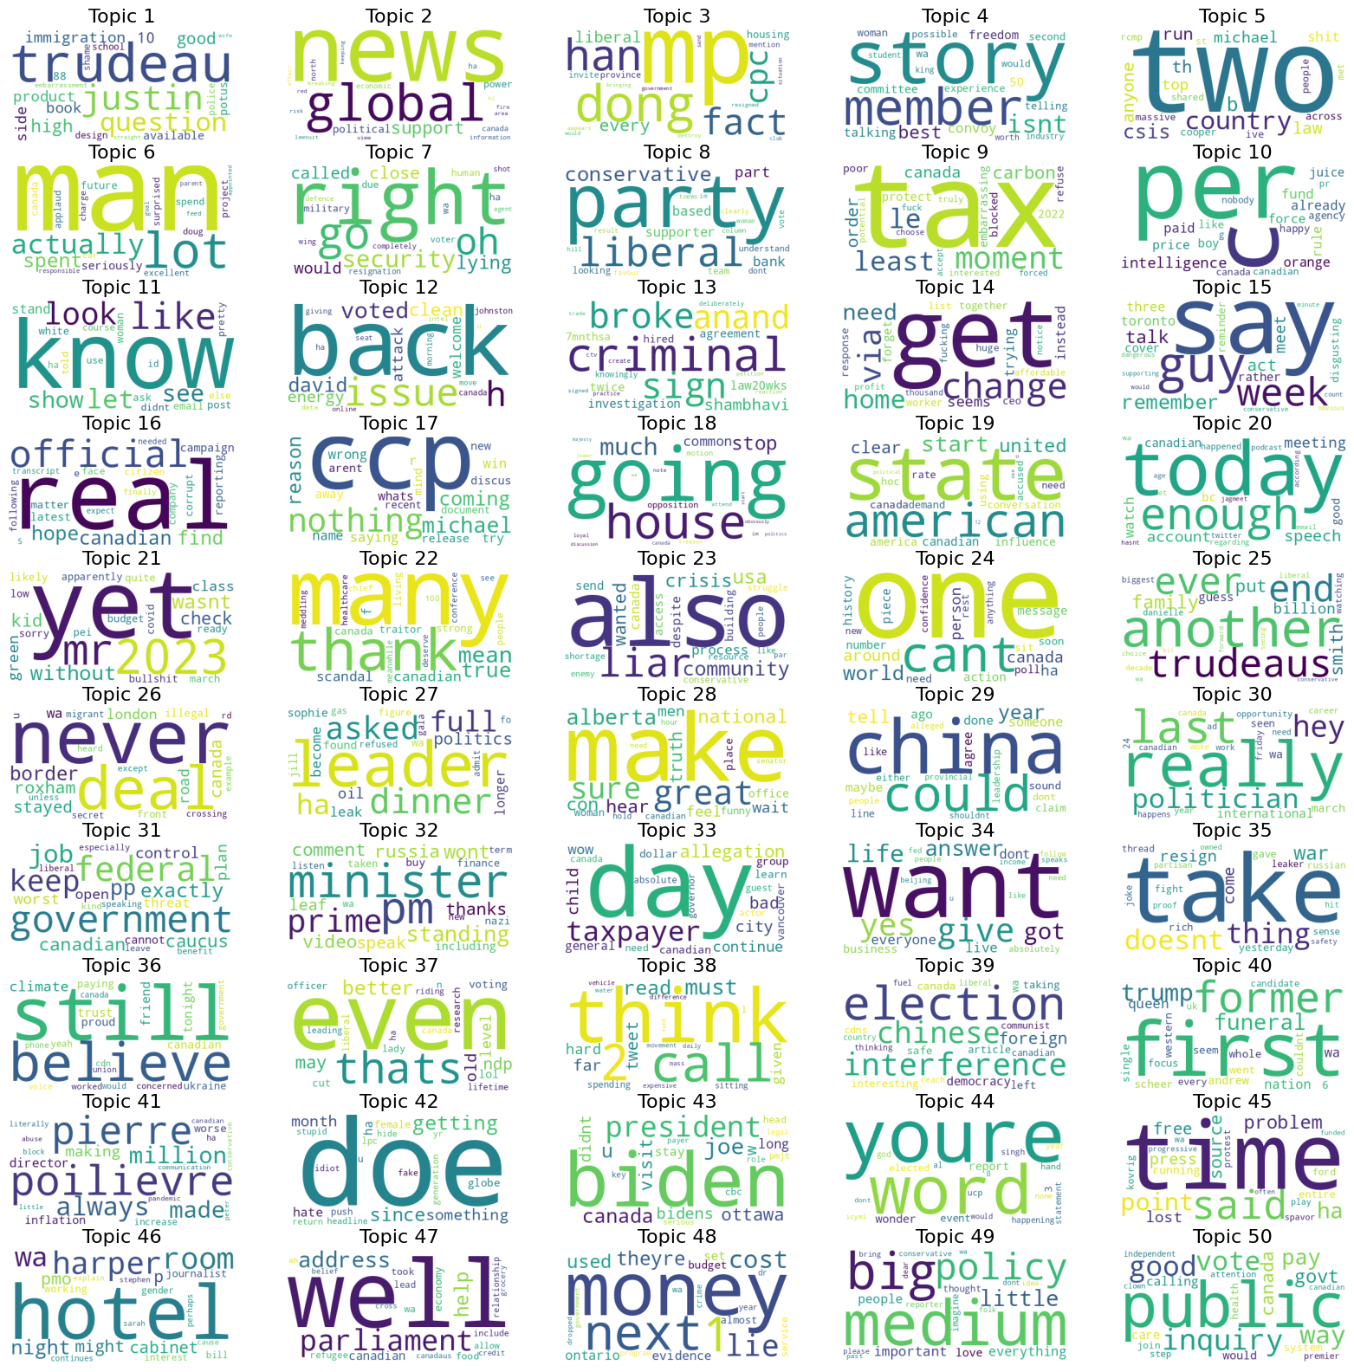
Results

Slide 9
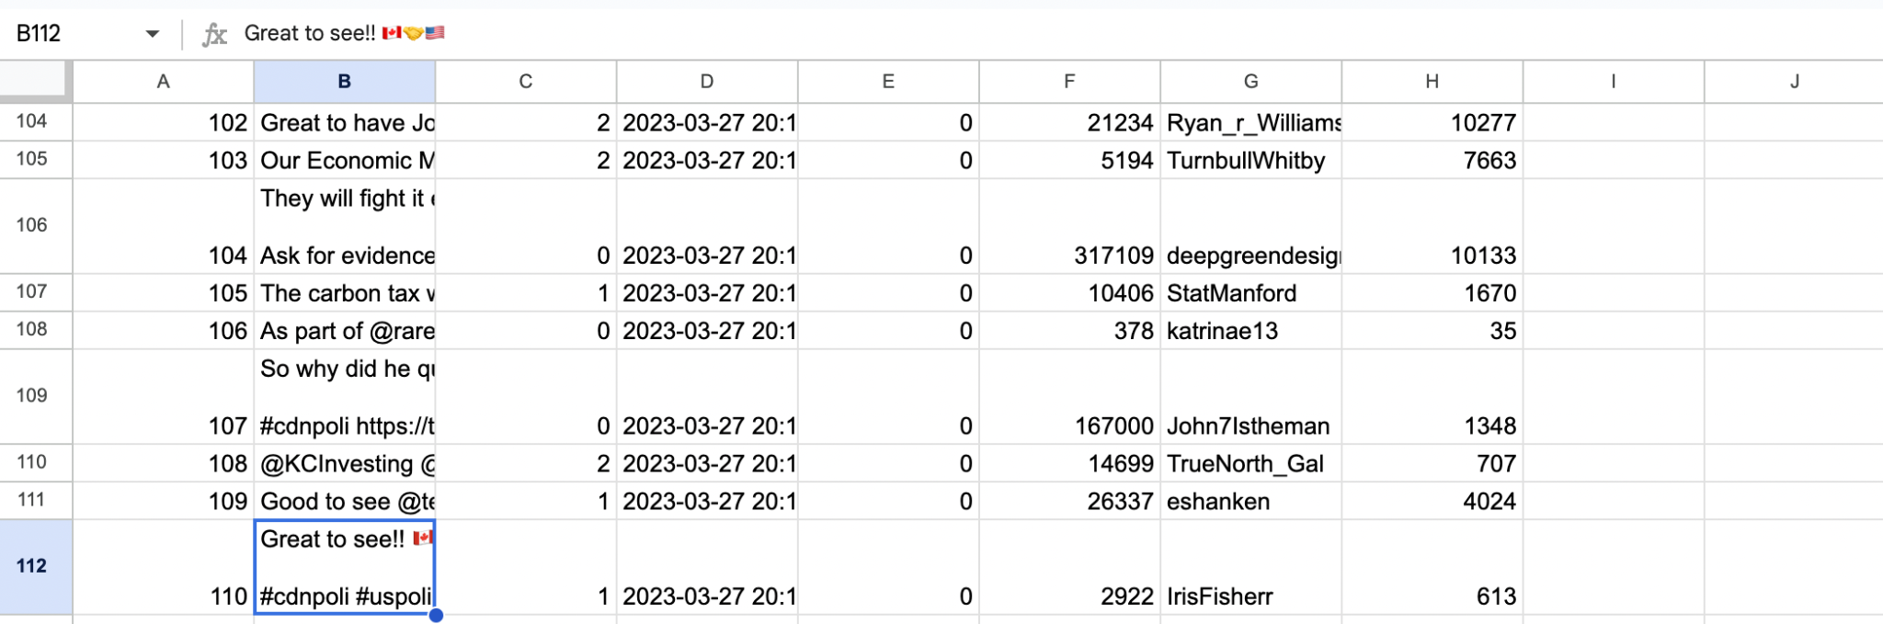
Conclusions & Improvements
Comparison with Supervised model
less manual input to train the tagged data
need high-quality data
Less accuracy
Future improvements
use a more advanced text preprocessing technique that can handle emojis, slang, and abbreviations commonly used on social media
No baseline model, but can compare with other Topic modeling algorithm (e.g. Latent Semantic Analysis)

Slide 10
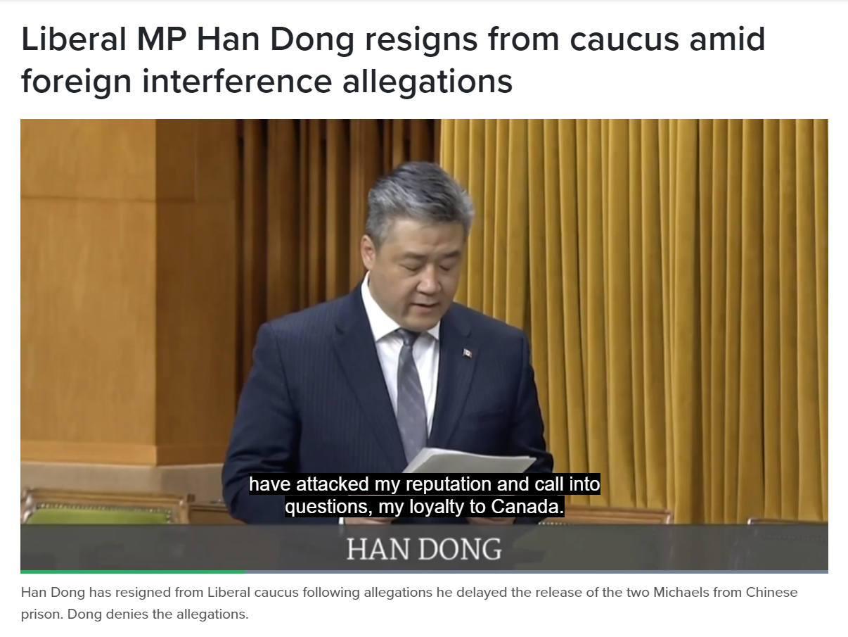
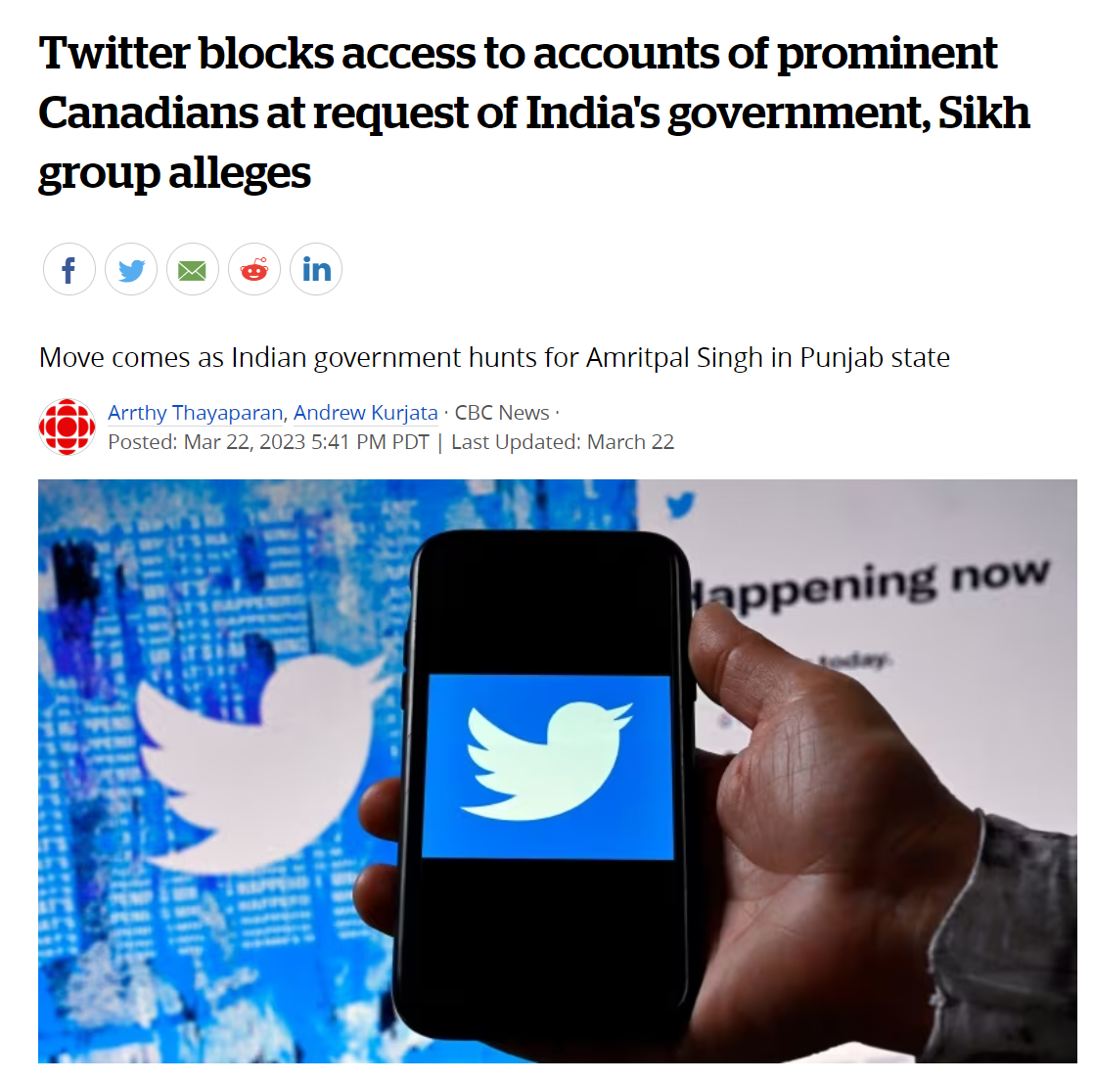
Topic 3:https://toronto.citynews.ca/2023/03/22/liberal-mp-han-dong-resigns-foreign-interference/
Topic 12:https://www.cbc.ca/news/politics/david-johnston-foreign-interference-analysis-wherry-1.6789841
Topic 13:https://twitter.com/ivanned1/status/1256015267101990913
Topic 20:https://www.cbc.ca/news/canada/british-columbia/twitter-canada-india-rupi-kaur-jagmeet-singh-1.6787760
Topic 25:https://www.hilltimes.com/wp-content/uploads/2023/03/032023_HT_1.pdf Titled: While fake scandals roil Ottawa
Topic 26:https://www.theglobeandmail.com/politics/article-roxham-road-deal-migrants/
Topic 40:https://www.vanityfair.com/news/2022/09/the-world-leaders-attending-the-queens-funeral-and-the-one-who-wont
Topic 41:https://cupe.ca/pierre-poilievre-wrong-about-inflation
Topic 43: https://www.cbc.ca/news/politics/joe-biden-arrives-in-canada-1.6787828

